Slide 1

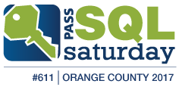
SQL Injections and How To Stop Them
Presented By:
Jeff Prom
BI Data Architect
Bridgepoint Education
MCTS - Business Intelligence, Admin, Developer

Slide 2












Please Support Our Sponsors
SQL Saturday is made possible with the generous support of these sponsors.
You can support them by opting-in and visiting them in the sponsor area.

Slide 3
Local User Groups
Orange County User Group
2rd Thursday of each month
bigpass.pass.org
Los Angeles User Group
3rd Thursday of each odd month
sql.la
Malibu User Group
3rd Wednesday of each month
sqlmalibu.pass.org
San Diego User Group
1st & 3rd Thursday of each month
meetup.com/sdsqlug
meetup.com/sdsqlbig
Los Angeles - Korean
Every Other Tuesday
sqlangeles.pass.org

Slide 4


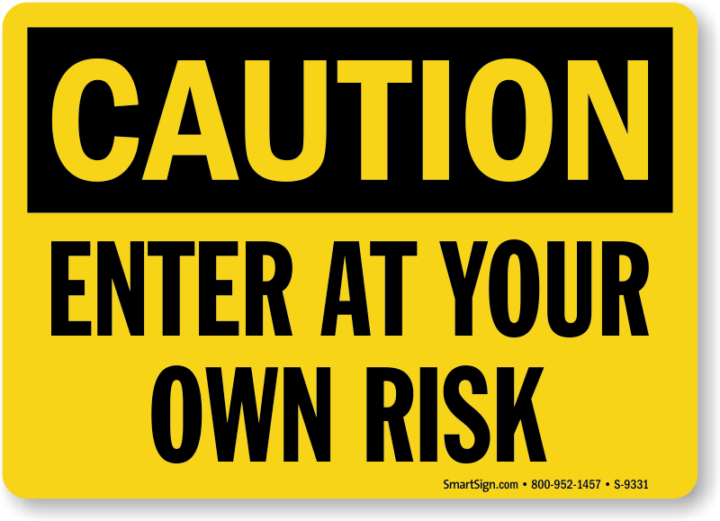

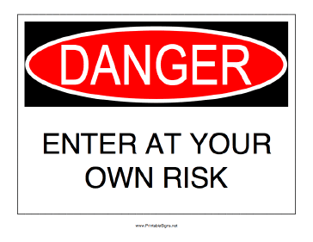


Slide 5
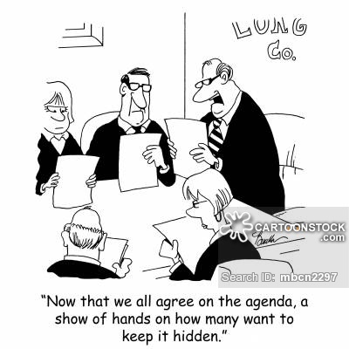
Agenda
What are SQL Injections?
What can they do?
Who is at risk?
How do SQL Injections work?
Identifying Attacks
Stopping SQL Injections
Questions

Slide 6


What are SQL Injections?

Slide 7


What are SQL Injections?
SQL injections are a code injection technique, used to attack data-driven applications, in which malicious SQL statements are inserted for execution.
A way of exploiting user input and SQL Statements to compromise the database and/or retrieve sensitive data.

Slide 8
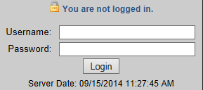
Two Types of User Input Methods
GET (passed through the URL)
POST (forms)

Slide 9

Types of SQL Injection Attacks
Blind SQL Injection
Enter an attack on one vulnerable page but it may not display results
A second page would then be used to view the attack results
Conditional Response
Test input conditions to see if an error is returned or not
Depending on the response, the attacker can determine yes or no information
First Order Attack
Runs right away
Second Order Attack
Injects data which is then later executed by another activity (job, etc.)
Lateral Injection
Attacker can manipulate values using implicit functions

Slide 10
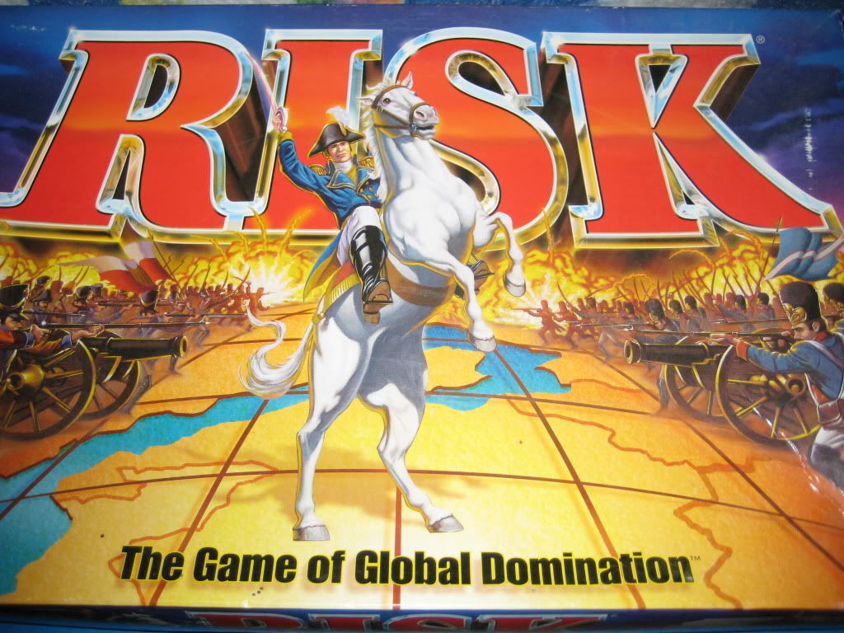
Who is at risk?
17 | 43

Slide 11

Who is at risk?
Any web application that accepts user input
Both public and internal facing sites
Public facing sites will likely receive more attacks than internal facing sites
In 2013, SQL Injection was rated the number one attack on the OWASP top ten.
Open Web Application Security Project (owasp.org)
Notes:
OWASP is an open community dedicated to enabling organizations to conceive, develop, acquire, operate, and maintain applications that can be trusted.

Slide 12

Jeremiah J. Jacks
Taught myself how to build software by the time I turned 11.
Homeschooled.
Never went to college.
Lives in Irvine, California
Taught myself how NOT to architect databases after "gaining access" to >1/2 the F500's by the time I turned 18.
Notes:
https://www.linkedin.com/in/jeremiahjjacks/

Slide 13

2002 - Guess.com
Guess.com was open to a "SQL injection attack"
Nineteen-year old programmer Jeremiah Jacks discovered the hole
Able to pull down 200,000 names, credit card numbers and expiration dates in the site's customer database
The episode prompted a year-long FTC investigation
Source: http://www.securityfocus.com/news/5968

Slide 14
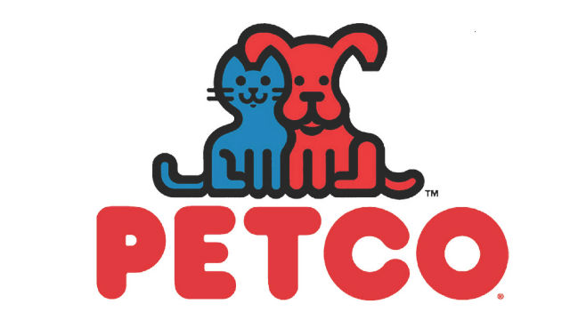
2003 - PetCo.com
Twenty-year old programmer Jeremiah Jacks discovered the hole
Jacks used Google to find active server pages on PetCo.com that accepted customer input, then simply tried inputting SQL database queries into them.
500,000 credit card numbers open to anyone able to construct a specially-crafted URL
"It took me less than a minute to find a page that was vulnerable," says Jacks. "Any SQL injection hacker would be able to do the same thing.“
Source: http://www.securityfocus.com/news/6194

Slide 15
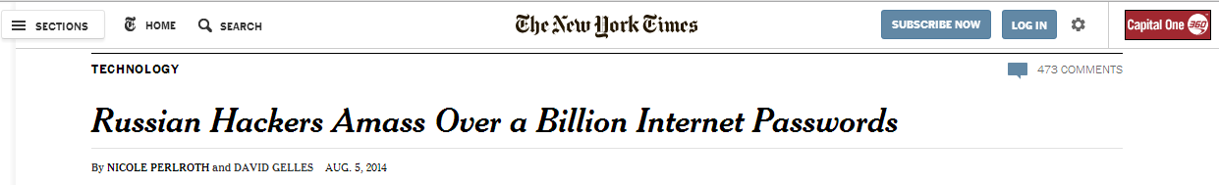
2014 - Multiple Sites
Hackers have amassed a vast collection of stolen data, including 1.2 billion unique username/password pairs, by compromising over 420,000 websites using SQL injection techniques.
Notes:
The Russia-based cyber gang is comprised of a dozen men in their 20’s.
The hackers pulled off the data heist, which ultimately scooped up 4.5 billion records, using unsuspecting systems of botnet network victims (in this case, computers with viruses that allowed a single operator to control a large group of affected systems) to test websites for SQL vulnerabilities. When a vulnerability was discovered, the hackers were then able to execute SQL injections, enabling them to send malicious commands to a website and steal its data, including usernames and passwords.
http://nakedsecurity.sophos.com/2014/08/06/1-2-billion-logins-scooped-up-by-cybervor-hacking-crew-what-you-need-to-do/
http://www.nytimes.com/2014/08/06/technology/russian-gang-said-to-amass-more-than-a-billion-stolen-internet-credentials.html?_r=1

Slide 16


Your Data
What can SQL Injections do?
17 | 43

Slide 17

What can SQL Injections do?
Retrieve sensitive information
Usernames/ Passwords
Credit Card information
SSN
Manipulate Data
Delete records
Truncate tables
Insert records
Manipulate Database Objects
Drop tables
Drop databases

Slide 18

What can SQL Injections do? (continued)
Retrieve System Information
Identify software and version information
Determine server hardware
Get a list of databases
Get a list of tables
Get a list of column names within tables
Manipulate User Accounts
Create new sysadmin accounts
Insert admin level accounts into the web-app
Delete existing accounts
xp_cmdshell

Slide 19

How do SQL Injections work?
17 | 43

Slide 20


Attack Techniques
Blind SQL Injection
http://localhost/htm/product-list.php?StatusFilter=' drop table DimUser --
SELECT * FROM DimUser WHERE UserName='jprom' and Password='' drop table DimUser --'
Conditional Response
http://localhost/htm/product-details.php?ID=603 and substring(@@VERSION,1,20) = 'Microsoft SQL Server‘
SELECT ProductKey FROM DimProduct WHERE ProductKey=603 and substring(@@VERSION,1,20) = 'Microsoft SQL Server'
Return a List of Data (Such as User Accounts)
http://localhost/htm/product-list.php?StatusFilter=' or 1=0 union select x=null, x=UserName, x=Password, x=null from DimUser --
SELECT ProductKey FROM DimProduct WHERE status='' or 1=0 union select x=null, x=UserName, x=Password, x=null from DimUser --' ORDER BY ProductAlternateKey

Slide 21

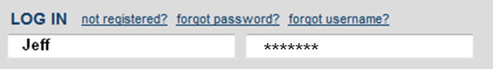
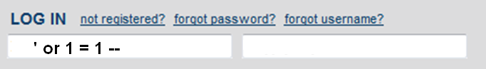
Bypassing Logins
$sql = "SELECT * FROM Users WHERE Username = '$username' and Password = '$password'";
SELECT * FROM Users WHERE Username= 'Jeff' and Password= 'password'
SELECT * FROM Users WHERE Username= ‘'or 1 = 1--‘ and Password=‘password’

Slide 22

Demo SQL Injection Attacks
23 | 43

Slide 23
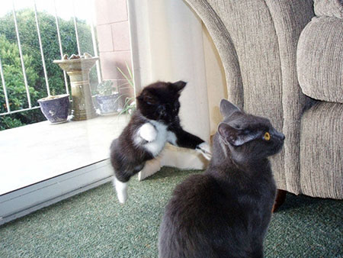
Identifying Attacks
17 | 43

Slide 24
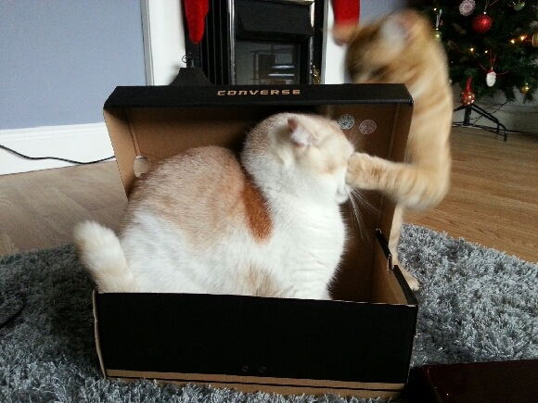
Identifying Attacks
sp_who2
Check for expensive queries
dbcc inputbuffer(spid #)
Activity monitor, recent expensive queries
Check running queries. sort by CPU time desc
Check recently executed queries for attack signatures
1=1 or ‘1’=‘1’
1=0 or ‘1’=‘0’
--
variations

Slide 25

Identifying Attacks
Evaluate profiler results
Look for injected SQL statements
Look for non-parameterized queries
Look for expensive queries (Injected SQL?)
Various Tools:
WebInspect by HP
http://sqlninja.sourceforge.net/
Web Vulnerability Scanners
Look for anything suspicious
Check source code for vulnerabilities!

Slide 26
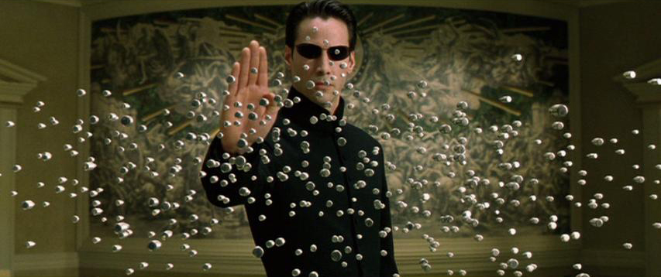
Stopping SQL Injections
17 | 43

Slide 27
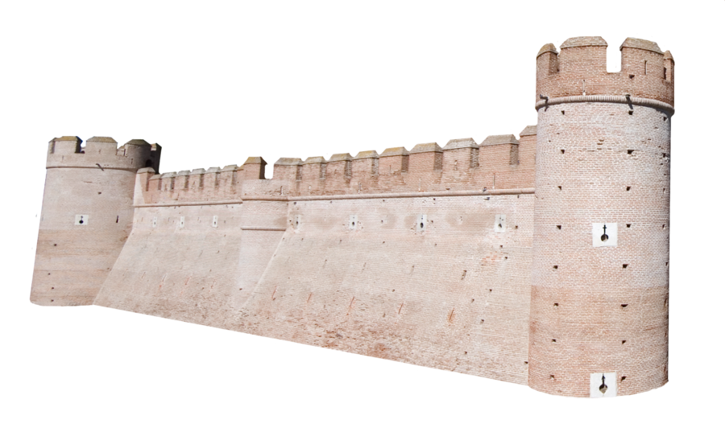
Strategies to Stop SQL Injection Attacks
Write code to identify and replace suspect looking strings?
Not a good idea
Impossible to identify all possible scenarios
Check incoming values before executing a query
If expecting a character value with a length of 2, use a substring with a length of 2
Incoming value might only be 1 of x possibilities
Check datatype and/or length of incoming values
(integer, char(2), etc)
Encrypt URL variable strings

Slide 28


Strategies to Stop SQL Injection Attacks
Use a web application firewall (WAF)
Don't return error messages to the screen (disable error messages)
Remove escape characters
Some languages have functions to help with this
Implement proper security
Use db_datareader, db_datawriter, or table level permissions
Not db_owner or sysadmin!
Encrypt sensitive data in the database
ALWAYS use Parameterized queries where user input is possible
Use on all queries using a GET or POST

Slide 29
Parameterized Queries
An execution plan is created on the server before the query is executed. The plan only allows the original query to be executed.
Injected SQL will not be executed because it is treated as a value and not as a statement.

Slide 30

Parameterized Queries – Code Example
Not Safe (Non-Parameterized)
$tsql_States = sprintf("SELECT * FROM vw_DimState WHERE stateCode='%s' AND countryCode='%s'", $_GET[‘State’], $_GET[‘Country’]);
$stmt_States = sqlsrv_query($conn, $tsql_States);
$row_States = sqlsrv_fetch_array($stmt_States, SQLSRV_FETCH_ASSOC);
Safe (Parameterized)
$tsql_States = "SELECT * FROM vw_DimState WHERE stateCode=? AND countryCode=?";
$params_States = array($_GET[‘State’], $_GET[‘Country’]);
$stmt_States = sqlsrv_query($conn, $tsql_States, $params_States);
$row_States = sqlsrv_fetch_array( $stmt_States, SQLSRV_FETCH_ASSOC);

Slide 31
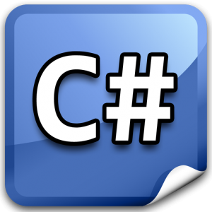
Parameterized Queries – Code Example (C#)
Select
string strQuery = "select * from customers where city = @city";
SqlCommand cmd = new SqlCommand(strQuery);
cmd.Parameters.AddWithValue("@city", txtCity.Text.Trim());
DataTable dt = GetData(cmd);
GridView1.DataSource = dt;
GridView1.DataBind();
Update
string strQuery;
SqlCommand cmd;
strQuery = "insert into customers (CustomerID, CompanyName) values(@CustomerID, @CompanyName)";
cmd = new SqlCommand(strQuery);
cmd.Parameters.AddWithValue("@CustomerID", "A234");
cmd.Parameters.AddWithValue("@CompanyName", "DCB");
InsertUpdateData(cmd);
Notes:
http://aspsnippets.com/Articles/Using-Parameterized-queries-to-prevent-SQL-Injection-Attacks-in-SQL-Server.aspx

Slide 32

Parameterized Queries Using Profiler
http://localhost/htm/product-details.php?ID=603 and substring(cast(SERVERPROPERTY('productversion') as varchar(20)),1,2)=11
Not Parameterized (Not Safe)
SELECT * FROM DimProduct WHERE ProductKey=603 and substring(cast(SERVERPROPERTY('productversion') as varchar(20)),1,2)=11
Parameterized (Safe)
exec sp_executesql N'SELECT * FROM DimProduct WHERE ProductKey=@P1',N'@P1 varchar(79)','603 and substring(cast(SERVERPROPERTY(''productversion'') as varchar(20)),1,2)=11‘
→ Conversion failed when converting the varchar value '603 and substring(cast(SERVERPROPERTY('productversion') as varchar(20)),1,2)=11' to data type int.

Slide 33
Demo Identifying & Stopping SQL Injections
23 | 43

Slide 34


Summary
SQL Injections can be malicious or retrieve sensitive information
Hackers only need 1 opportunity to compromise security for the entire web app
Enforce proper database security
Suppress error messages
Sanitize inputs
Always use parameterized queries where user input is involved

Slide 35




Jeff Prom
Questions?
Thank You!
Blog: http://jeffprom.com
Email: jeffprom@gmail.com
LinkedIn: www.linkedin.com/in/JeffProm

